Slide 1
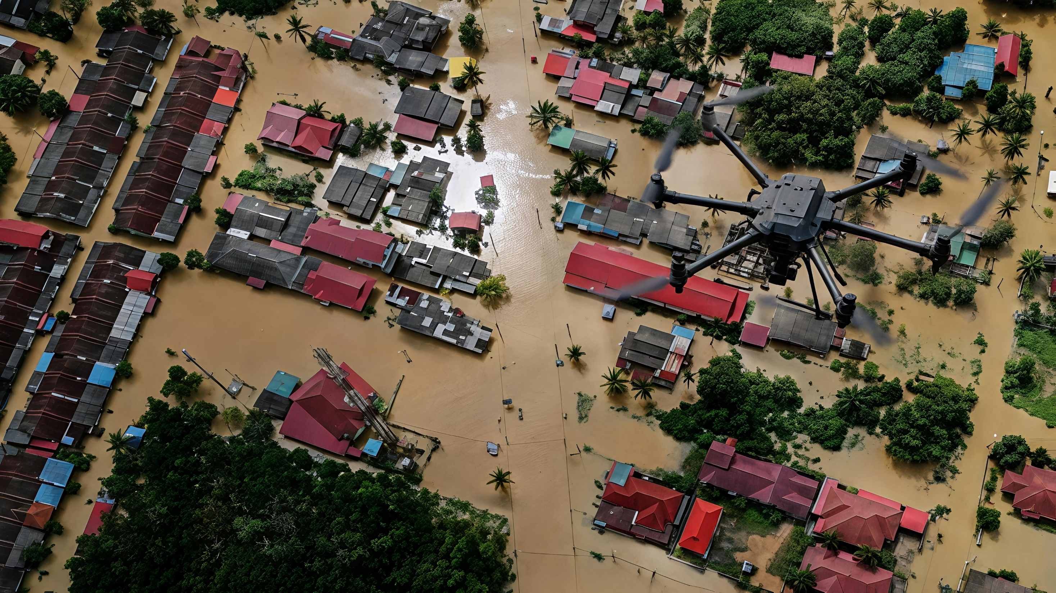
Disaster Response Drone
for Remote Areas
DTIE | Department of Multi Disciplinary Innovation & Entrepreneurship
Presented by
Group No.: 9
Under the supervision of:
Dr. G. Sudhakar
Subject: DTIE
1. Nikhil Srivatsa – 2620090029
2. Sai Hitesh – 2620030269
3. Sai Tanush – 2620040075
4. Srujana – 2620090032
5. Nayani - 2620040007
6. Thanmayi - 2620040164

Slide 2
Disaster Response Drone
for Remote Areas
Presented by
Group No.: 9
Sai Hitesh – 2620030269
2. Nayani – 2620040007
3. Sai Tanush - 2620040075
4. Thanmayi - 2620040164
5. Nikhil Srivatsa – 2620090029
6. Srujana – 2620090032
Under the supervision of:
Dr. G. Sudhakar
Subject: DTIE
DTIE | Department of Multi Disciplinary Innovation & Entrepreneurship
Abstract / Proposal
Introduction (why, advantages, techniques)
Objectives
Background study / literature survey
Methodology
Software components
Hardware components
Results
Conclusion

Slide 3
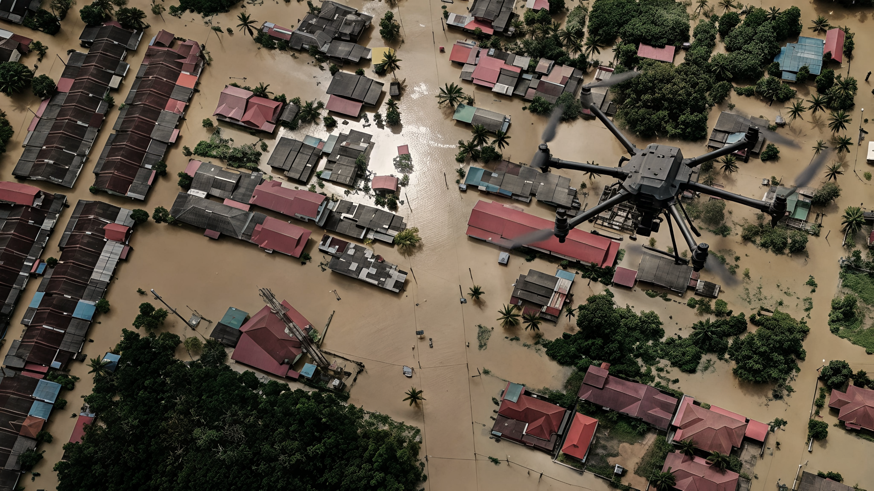
Vision and Mission
> Problem faced during disasters
> Empathy
> Defining the Problem statement
>Research and Background study
>Market and Industrial Study
>Target Users and Costumers
>Competitors and Benchmarks
>Proposed Competitive Advantage
> Idea Generation
> Multi voting
> Proposed Drone Concept, Idea, Prototype, Solution
>System Architecture
>Risk and Gaps
>Lean Canvas model
> Rough Prototype – Working
>Capital and Finance
> Demonstration
> Outcome and Conclusion
Agenda
DTIE | Department of Multi Disciplinary Innovation & Entrepreneurship

Slide 4
Vision and Misson
Our Vision: To make disaster response faster, safer, and more effective by using affordable drone technology to locate survivors in remote and disaster-affected areas.
Our Mission:
Develop a drone-based survivor detection and monitoring system.
Integrate thermal imaging, GPS, cameras, and real-time communication.
Reduce risks to rescue personnel and improve emergency response.
Explore cost-effective thermal sensing using locally developed semiconductor technology.
DTIE | Department of Multi Disciplinary Innovation & Entrepreneurship

Slide 5
Problem faced during disasters
During disasters such as floods, earthquakes, landslides, and forest fires, remote areas may become dangerous or impossible for rescue teams to access.
Main problems are:
Rescue teams may not be able to reach affected locations quickly.
Finding trapped or stranded people takes time.
Rescuers may be exposed to dangerous conditions.
Communication and information from remote locations may be limited.
Survivors may be difficult to detect at night or in low visibility.
Roads may be blocked because of floods, landslides, or debris.
Delay in rescue operations can increase the risk to victims.
Therefore, we need a fast and safe system to locate survivors, monitor disaster areas, and provide real-time information to rescue teams.
DTIE | Department of Multi Disciplinary Innovation & Entrepreneurship

Slide 6
Empathy: Survivors
So basically, We considered the problems faced by both disaster victims and rescue teams.
During Disasters, survivors may be trapped in damaged building, isolated by floods, or stranded in areas that are difficult to reach.
They mainly need
Quick detection
Faster rescue
Accurate location identification
Emergency medicines and food
Continuous support until rescuers arrive
Understanding these needs helps us design a system that focuses on saving lives and reducing rescue delays.
DTIE | Department of Multi Disciplinary Innovation & Entrepreneurship

Slide 7
Empathy: Rescue Teams
Rescue teams often work in unsafe environments where there may be floods, debris, landslides, blocked roads, or poor visibility.
They require:
Real-time information
Accurate survivor locations
Safe inspection of dangerous areas
Better visibility in darkness
Information about blocked or unsafe routes
DTIE | Department of Multi Disciplinary Innovation & Entrepreneurship

Slide 8
Defining the Problem Statement
After understanding the users' problems, the problem can be clearly defined as:
“How might we develop a drone-based disaster response system that can quickly locate survivors, monitor dangerous and inaccessible areas, provide their accurate location, and send real-time information to rescue teams while reducing risks to human rescuers?”
The main aim is to reduce the risk to human rescuers and support faster rescue operations.
DTIE | Department of Multi Disciplinary Innovation & Entrepreneurship

Slide 9
Research and Background Study
Existing technologies such as unmanned aerial vehicles, thermal cameras, GPS modules, and AI-based image processing can support disaster-response operations.
Thermal imaging: Detects infrared radiation and highlights temperature differences that may indicate human presence.
GPS/GNSS: Provides geographical coordinates for navigation and location recording.
RGB camera: Captures visible-light images for visual inspection.
AI image processing: Helps identify possible human figures or heat patterns.
Wireless communication: Transfers coordinates, images, and system status to rescue teams.
Combining these technologies may improve search efficiency, but actual performance must be validated through prototype testing.
A 2020 Vietnam floods and landslides case study in our project presentation describes the use of DJI Matrice 300 RTK drones with Zenmuse H20T thermal cameras for disaster-area assessment.
DTIE | Department of Multi Disciplinary Innovation & Entrepreneurship

Slide 10
Market and Industrial Study
Industry: Unmanned Aerial Vehicles (UAVs), thermal imaging, artificial intelligence, and disaster management.
Applications: Flood rescue, earthquake response, landslide assessment, wildfire monitoring, and emergency supply delivery.
Potential demand: Disaster management agencies, fire departments, emergency services, and search-and-rescue organizations.
Market opportunity: Affordable, modular drones that combine survivor detection, location estimation, and real-time communication.
Research Gap
Existing drone systems can support aerial monitoring and thermal detection, but challenges remain in affordability, battery life, detection accuracy, weather resistance, and communication reliability
DTIE | Department of Multi Disciplinary Innovation & Entrepreneurship

Slide 11
Target Uses and Costumers
The system is intended for organisations that conduct emergency response and disaster assessment.
Primary customers:
Government disaster-management authorities.
Fire and rescue departments.
Search-and-rescue organisations.
Emergency response agencies.
Humanitarian and disaster-relief organisations.
Beneficiaries:
People trapped in disaster-affected areas.
Remote and isolated communities.
Emergency medical teams.
Local authorities and rescue coordinators.
These users require timely information, reliable location estimates, safe operation, and manageable equipment costs.
DTIE | Department of Multi Disciplinary Innovation & Entrepreneurship

Slide 12
Competitors and Benchmarks
Existing technologies provide useful reference points for the proposed project.
DJI Matrice 300 RTK with Zenmuse H20T: An enterprise drone platform with thermal and visual imaging capabilities.
Other thermal-imaging drones: Used for aerial inspection, night-time monitoring, and search operations.
Fixed-wing survey drones: Suitable for covering large geographical areas.
Ground-based rescue equipment: Useful for specialised inspections and close-range searches.
The proposed system focuses on combining essential detection and communication functions in a modular design. Performance comparisons should be based on verified specifications and practical testing.
DTIE | Department of Multi Disciplinary Innovation & Entrepreneurship

Slide 13
Benchmark Parameters
The proposed drone can be evaluated against existing systems using measurable performance parameters.
Detection capability: Ability to identify possible survivors under different conditions.
Flight time: Duration of operation on a single battery charge.
Coverage: Area that can be searched during a mission.
Location accuracy: Reliability of the estimated survivor coordinates.
Communication range: Distance over which useful information can be transmitted.
Weather resistance: Ability to operate safely in suitable environmental conditions.
Cost: Initial purchase, maintenance, and operating expenses.
DTIE | Department of Multi Disciplinary Innovation & Entrepreneurship

Slide 14
Proposed Competitive Advantage
The proposed design aims to provide a practical and potentially cost-effective solution for disaster-response applications.
Key advantages:
Integration of thermal imaging and RGB cameras.
GPS-based location recording.
AI-assisted identification of possible survivors.
Real-time transmission of images and coordinates.
Modular architecture for future upgrades.
Potential cost reduction through local sourcing and component selection.
The actual competitive advantage will depend on prototype performance, component costs, reliability, and comparison with existing systems.
DTIE | Department of Multi Disciplinary Innovation & Entrepreneurship

Slide 15
Idea Generation
Thermal camera for survivor detection.
GPS for location tracking.
AI for identifying survivors.
Real-time communication with rescue teams.
Automated flight control for efficient searching.
Camera for visual monitoring.
DTIE | Department of Multi Disciplinary Innovation & Entrepreneurship

Slide 16
Multivoting
Our team evaluated ideas based on safety, cost, feasibility, and rescue effectiveness.
Selected Ideas:
Thermal survivor detection
GPS location tracking
High-resolution camera
Real-time communication
Automated flight control
These features were highly selected because they directly support survivor detection and faster rescue response.
DTIE | Department of Multi Disciplinary Innovation & Entrepreneurship

Slide 17
Proposed Drone Concept, Idea,Prototype,Solution
Concept: Use a drone to assist survivor detection in disaster-affected areas.
Idea: Combine thermal sensing, a camera, GPS, and wireless communication.
Prototype: Build a basic system to demonstrate the detection and location-reporting process.
Product: Develop a reliable, tested, and user-friendly system.
Solution: Provide rescue teams with useful aerial information to support faster and safer decision-making.
The current concept is a proposed design; further development and validation are needed before operational use.
DTIE | Department of Multi Disciplinary Innovation & Entrepreneurship

Slide 18
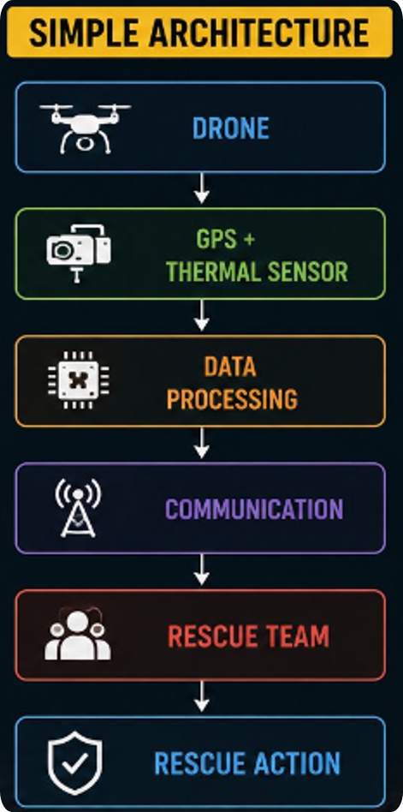
System Architecture
The system architecture shows how the drone collects and sendsinformation to the rescue team.
Basic Flow:
Drone → Sensors → Data Processing → Communication →Rescue Team
Drone: Flies over the disaster area.
Sensors: Collect GPS and thermal information.
Data Processing: Processes the collected data.
Communication: Sends the data to the rescue team.
Rescue Team: Uses the information to locate possible survivors.
DTIE | Department of Multi Disciplinary Innovation & Entrepreneurship

Slide 19
Risk and Gaps
S. No. | Risk / Gap | Impact | Mitigation
1 | Limited Battery Life | Reduces flight time and coverage. | Use high-capacity batteries.
2 | Weather Dependency | Affects flight stability. | Use weather-resistant drones.
3 | High Equipment Cost | Increases project cost. | Use affordable components.
4 | Detection Errors | Causes false alarms. | Combine AI, thermal, and RGB cameras.
5 | Communication Failure | Delays rescue operations. | Use backup communication systems.
6 | GPS Errors | Provides inaccurate locations. | Combine GPS with IMU data.
7 | Regulatory Restrictions | Delays drone deployment. | Obtain flight permissions.
8 | Lack of Skilled Operators | Affects safe operation. | Train operators.
9 | Slow Data Processing | Delays survivor detection. | Optimize AI models.
10 | Safety and Privacy Risks | May cause accidents or data misuse. | Follow safety rules and secure data.
DTIE | Department of Multi Disciplinary Innovation & Entrepreneurship

Slide 20
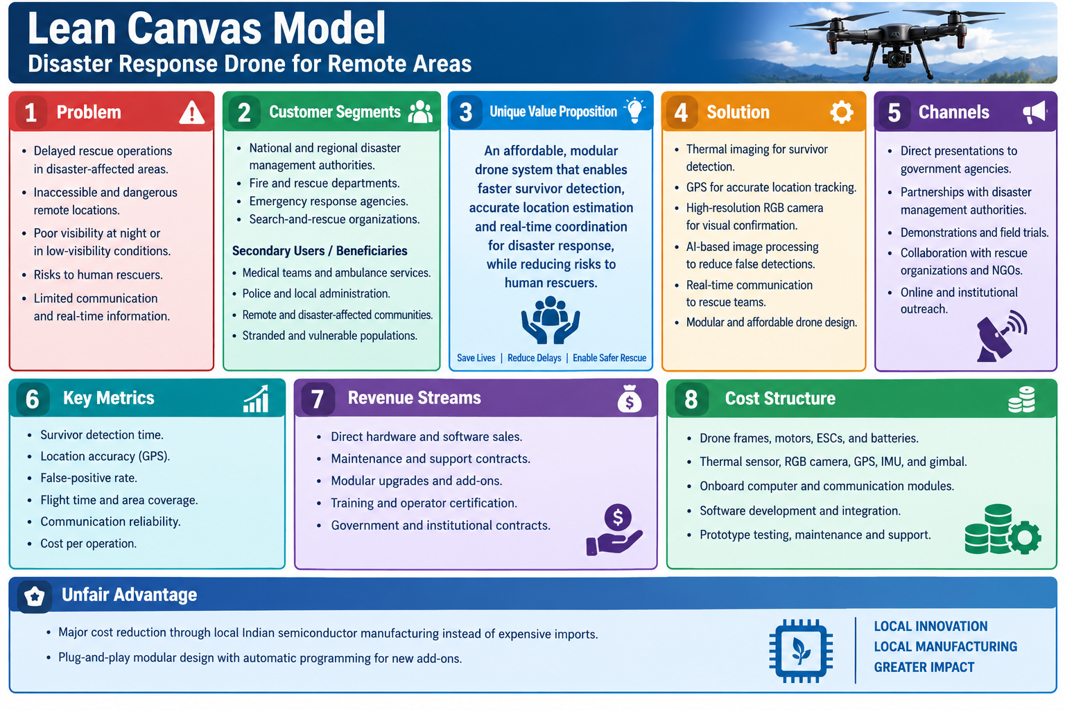
Lean Canvas Model
DTIE | Department of Multi Disciplinary Innovation & Entrepreneurship

Slide 21
Rough Prototype - Working
The prototype demonstrates the basic working sequence of the system.
Main components:
Drone frame and propulsion system.
Flight controller and battery.
Thermal camera and RGB camera.
GPS/GNSS module and IMU.
Onboard processing unit.
Wireless communication module.
Camera mount or gimbal.
Ground station for receiving and displaying data.
Flow:
Drone Launch → Area Scan → Survivor Detection → GPS Location → Data Transmission → Rescue Support
DTIE | Department of Multi Disciplinary Innovation & Entrepreneurship

Slide 22
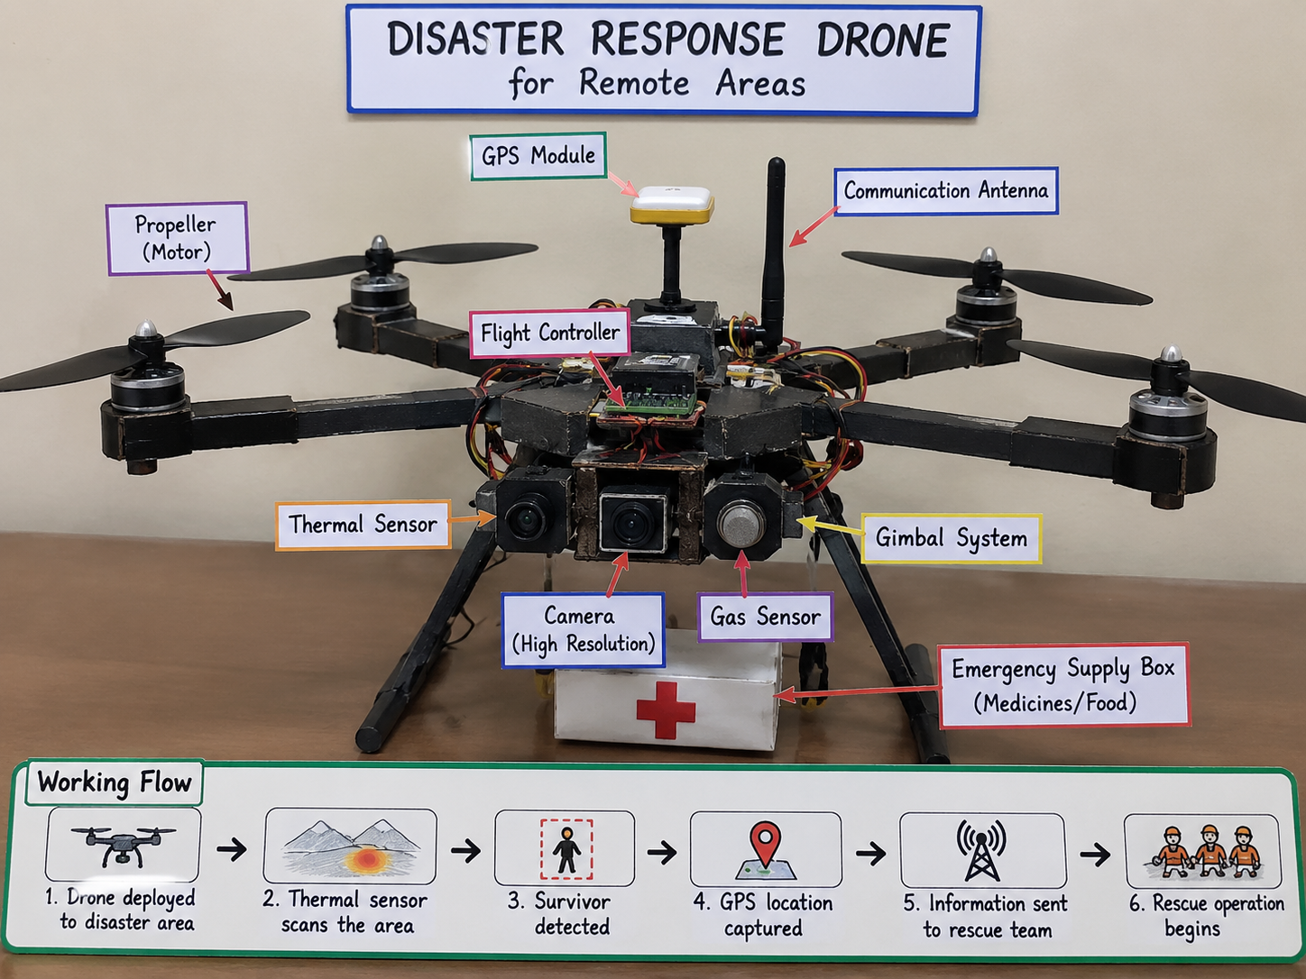
Rough Prototype
DTIE | Department of Multi Disciplinary Innovation & Entrepreneurship

Slide 23
Capital and Finanace
Component | Estimated cost
Drone hardware | ₹15,000
Thermal and RGB cameras | ₹25,000
GPS and communication modules | ₹5,000
Processing unit and controller | ₹10,000
Software development | ₹5,000
Testing and maintenance | ₹5,000
Total estimated capital | ₹65,000
The project requires funding for hardware, sensing components, software, and testing.
Estimated project budget:
Potential funding sources:
College project funding.
Government grants and schemes.
Startup funding and investors.
Partnerships with disaster-management organisations.
DTIE | Department of Multi Disciplinary Innovation & Entrepreneurship

Slide 24
Demonstration Scenario
Scenario: Flooded Remote Village
A village is affected by heavy flooding. Roads are blocked, and rescue teams are unable to enter the area safely. Some people may be trapped on rooftops or inside damaged buildings.
The disaster response drone is deployed to inspect the affected location. It flies over the flooded region and uses its sensors and camera to search for survivors.
DTIE | Department of Multi Disciplinary Innovation & Entrepreneurship

Slide 25
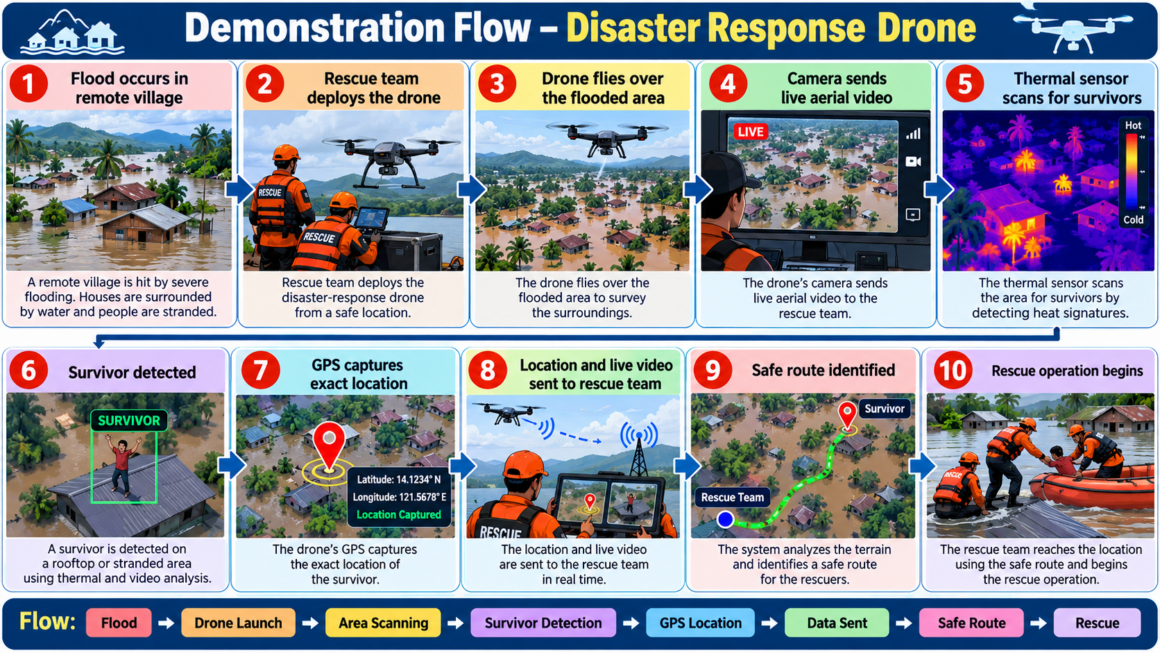
DTIE | Department of Multi Disciplinary Innovation & Entrepreneurship

Slide 26
Expected Outcome
Faster identification of possible survivors in disaster-affected areas.
Improved estimation and transmission of survivor locations.
Better access to remote and hazardous locations.
Reduced exposure of rescue personnel to dangerous environments.
Improved situational awareness and rescue coordination.
Potential application across floods, earthquakes, landslides, and forest fires.
DTIE | Department of Multi Disciplinary Innovation & Entrepreneurship

Slide 27
Conclusion
The Disaster Response Drone for Remote Areas combines thermal imaging, GPS, AI-assisted detection, and real-time communication to support search-and-rescue operations. By providing timely information from inaccessible locations, the proposed system can help rescue teams plan their operations more effectively. Further prototype testing, performance validation, and cost optimization are necessary before operational deployment.
DTIE | Department of Multi Disciplinary Innovation & Entrepreneurship

Slide 28
Thank You
DTIE | Department of Multi Disciplinary Innovation & Entrepreneurship

